Slide 1
Water Quality Analysis and Prediction
1.Adhithya S
2.Ashwin Kumar r
3.HARISH S

Slide 2
Objective
To Create a machine learning model for water quality analysis and prediction

Slide 3
Technologies Used
Python
Jupyter Notebook
Machine Learning Algorithms(Decision Tree Classifier)

Slide 4
Introduction
Water is perhaps the most precious natural resource after air.
Though the surface of the earth is mostly consists of water, only a small part of it is usable, which makes this resource limited.
This precious and limited resource, therefore, must be used with care. As water is required for different purposes, the suitability of it must be checked before use. Also, sources of water must be monitored regularly to determine whether they are in sound health or not.
Poor condition of water bodies are not only the indictor of environmental degradation, it is also a threat to the ecosystem. In industries, improper quality of water may cause hazards and severe economic loss.
Thus, the quality of water is very important in both environmental and economic aspects. Thus, water quality analysis is essential for using it in any purpose..

Slide 5
Abstract
Now a days many people are suffering from dangerous diseases which are caused due to impure water. In our project we are doing analysis for water quality monitoring system, it gives data about the quality of water, on a webpage.
The quality of water is determined using various sensors like PH sensor and turbidity sensor, connected to the Arduino family microcontroller.
The data will be transferred constantly from the remote sensor organize through microcontroller and wifi.
The total data regarding the purity of water is displayed in the webpage and is analysed in the form of graph, pie chart and values are given in the table. We transfer this information to cloud and clients can get to this information through web page application, client from anyplace can screen the data whenever.

Slide 6
Existing System
In the existing system the water quality will be checked by the Ph and turbidity sensors which are connected to the Node MCU microcontroller. The data is collected and is sent to the cloud for storage.

Slide 7
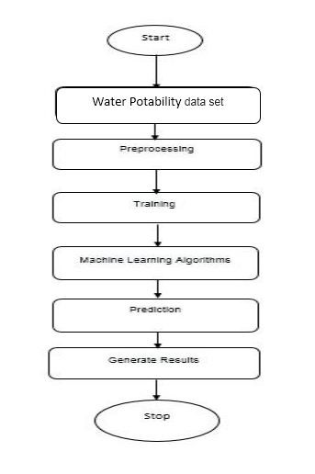
Block Diagram

Slide 8
Proposed System
In the proposed system water quality is analysed using certain parameters like pH value , hardness , solids , chloramines , sulfate , conductivity , organic_carbon , trihalomethanes , turbidity and potablity

